Slide 1
Doc. 1.2: Adoption of the Agenda and Methods of Work for the Online Session
WMO RA VI Nineteenth Session (Phase I)

Slide 2
Justification and background
Four-Year Cycle: RA VI sessions are held every four years to address strategic and technical priorities. Two-Phase Approach: As part of WMO reforms, RA VI-19 follows the two-phase structure initiated in RA VI-18. Online Phase I: The first phase, with focus on scientific and technical matters, will be conducted online on 15-16 October 2024, from 1 PM to 4 PM Geneva time.
In-Person Phase II, planned for October 2026, with focus on strategic matters, including elections.
Agenda: Aligned with WMO General Regulation 136 and includes items agreed by the RA VI Management Group, focusing on key WMO and RA VI initiatives.

Slide 3
Document Content
Key Components of the Draft Decision 1.2/1 (RA VI-19(I)):
Draft General Summary of the Work of the Session: A comprehensive summary capturing the key outcomes, discussions, and decisions made during the session.
Appendix to Draft Decision 1.2/1 (RA VI-19(I)): Provisional Agenda: An outline of the key topics and issues to be addressed throughout the session, ensuring structured and efficient progress.
Annex to Draft Decision 1.2/1 (RA VI-19(I)): Methods of Work for the Online Session: Guidelines and procedures to ensure smooth and effective virtual session management, including participation, and documentation.

Slide 4
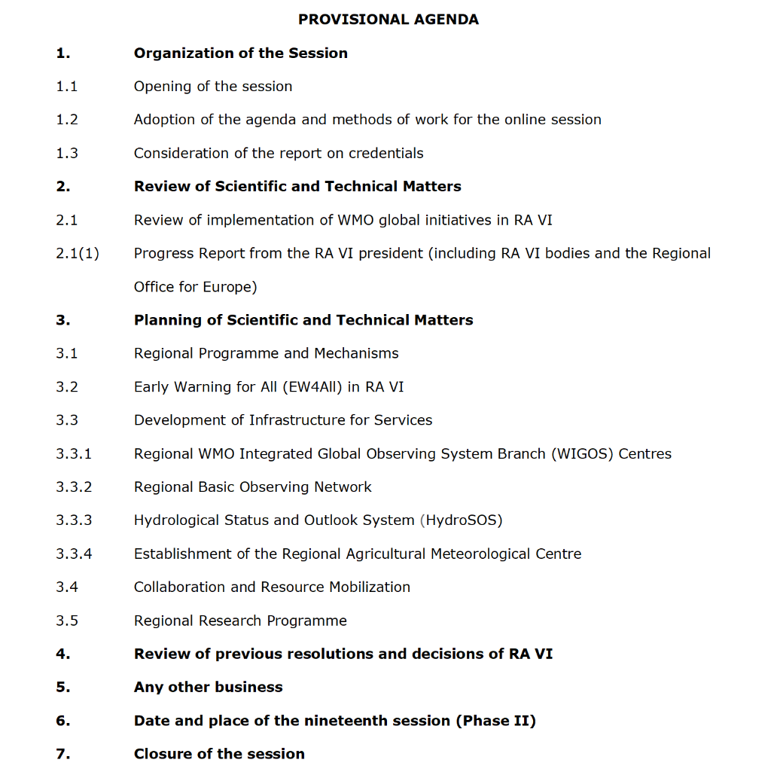

Slide 5
Action Required from RA VI-19
Adopt the overall summary, capturing key outcomes and decisions for the record.
Approve the proposed agenda to guide discussions and ensure focus on key priorities.
Adopt the Methods of Work for conducting the online session efficiently and inclusively.

